Slide 1

STAT 515
PROJECT: analyzing minimum wages in united states from 1968 TO 2020

Slide 2
Introduction
The project is about visualizing and analyzing the USA minimum wage by State from 1968 – 2020.
To explore how minimum wage defined by both federal and state government has changed over the years in different states of United States.
To analyze how minimum wage of different states are coping up with CPI avg over the years in the US economy.

Slide 3
Data source:
https://www.kaggle.com/
United States Department of Labour

Slide 4
Software and packages:
R STUDIO SOFTWARE
In R STUDIO, Packages installed are micomapST, tidyverse, choroplethr, plotly.

Slide 5
Initial plot
As the Conclusions can’t be drawn easily, a story cannot be told in a clear way
Color Collision

Slide 6
micromap
Micromap depicting how effective minimum wage has changed in 1968 and 2020 for all the states in USA.

Slide 7
Choropleth Map
The plot gives an idea on the adaption of either federal or state minimum wage by all the states of USA in 1968 and 2020

Slide 8
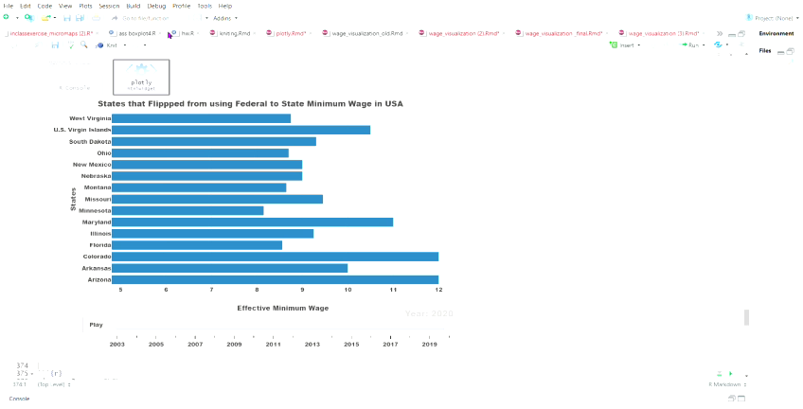
plot
Around 2003, these states started adapting their own minimum wage and changes of the same over the years is depicted here in the visual.

Slide 9
Line plots
We have chosen these top 5 states of 1995 and 2020 with high effective minimum wage to watch the trend.
Reason for choosing top 5 states in 1995 and 2020 being to observe the trend on how the minimum wage is varying over the years among them.
From the visualization we observed that Effective minimum wage before 1995 was mostly on the same scale with federal minimum wage.

Slide 10
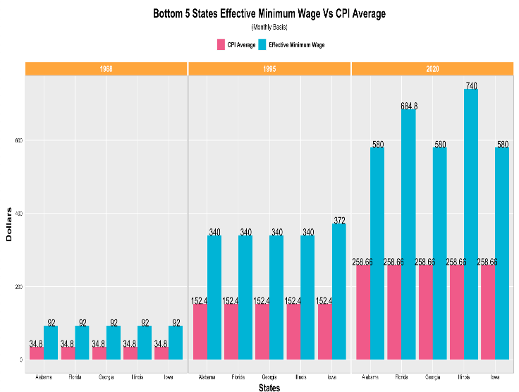
GROUPED BAR PLOT
This plot represents the Effective Minimum Wage vs CPI Average of states with lowest minimum wages.
Findings:
In 1968, the standard of living is comparatively low when compared to 2020.

Slide 11
Conclusion
Drastic flip from Federal to State minimum wage from 2004 due to massive spike in USA economy and also because of new amendments passed by the government
DC has the highest Effective minimum wage of 15$ per hour by 2020
Even the bottom 5 states after 1995, are able to bare minimum consumer expenditure due to federal minimum wage.

Slide 12
Thank you!
Group 10:
Krishna Chaitanya Bandlamudi
Sai Rahul Gummalla
Vishnu Lasya Marthala
Anusha Pininti

